Slide 1
Our school
Szkoła Podstawowa im. Krola Zygmunta Augusta w Wasilkowie

Slide 2
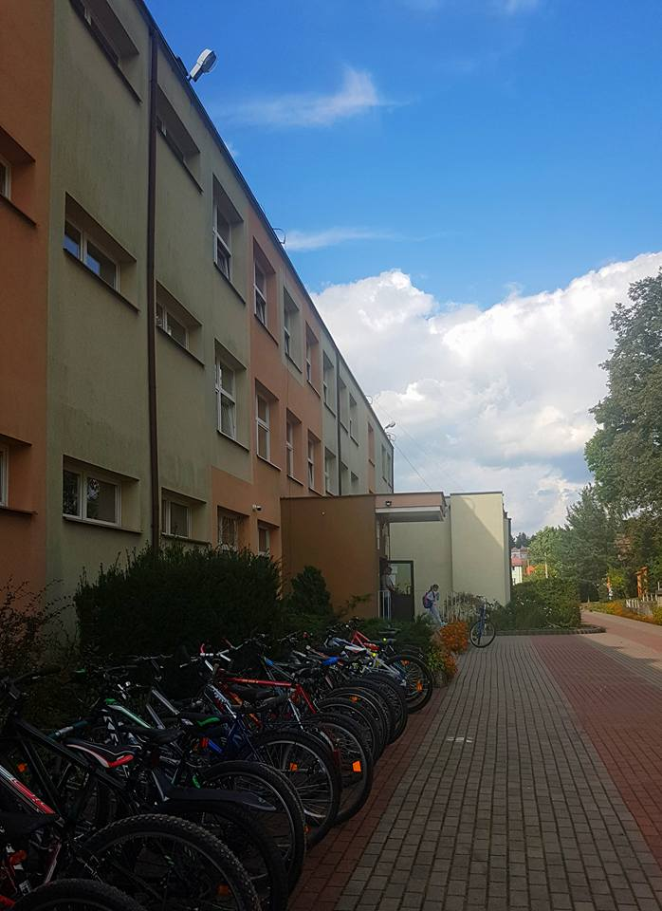
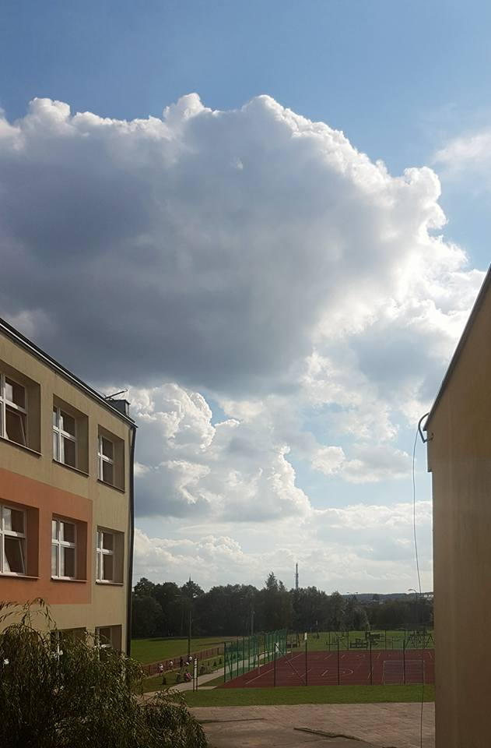
Our school
School is located in the north-east part of Poland in a small town Wasilków.
Head teacher is Anna Ewa Fidurska.
The school has 959 students and 100 teachers.

Slide 4
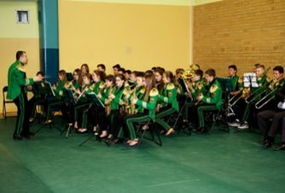
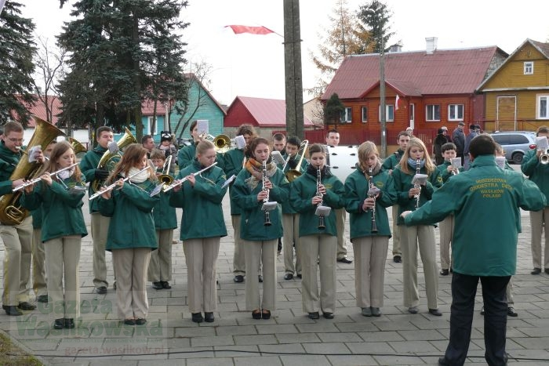
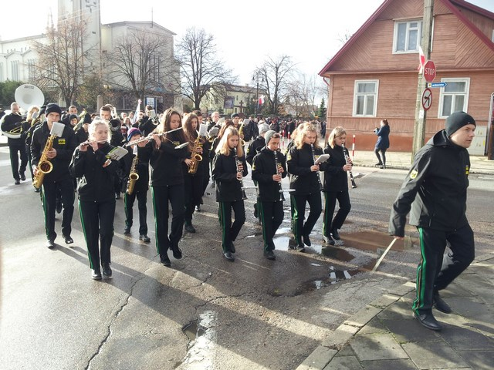
School's orchestra

Slide 5
Keeping fit is one of the most important thing in our school. Our PE teachers care about pupils’ health and balance. Every year they organise competiotions between schools.
SPORT

Slide 6
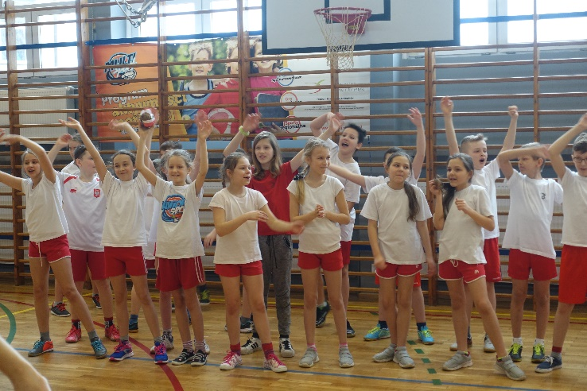
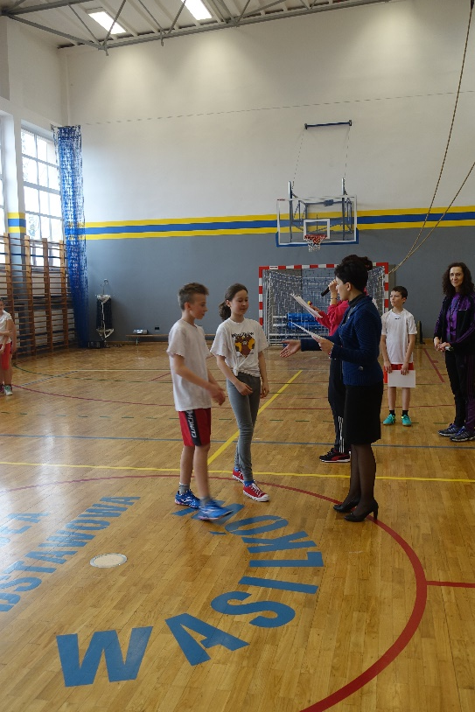
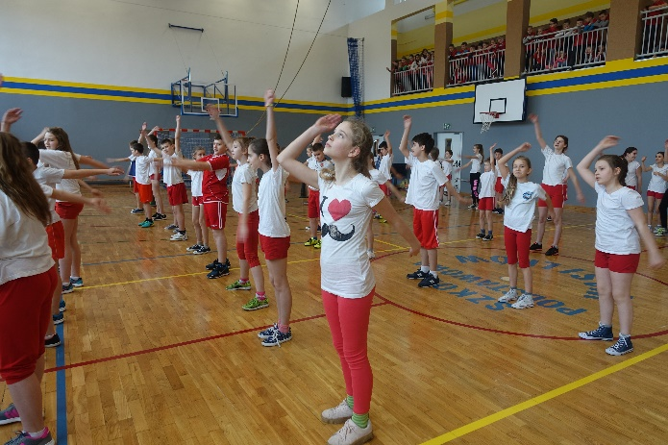
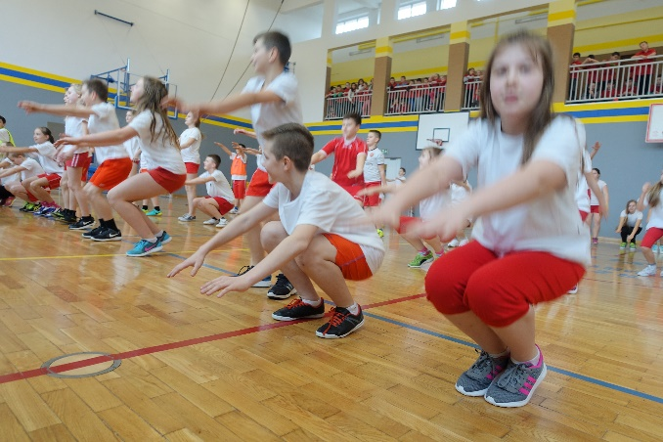
Keep balance and move on

Slide 7
School’s Got Talent
Every year in our school student council organise „School’s Got Talent” This day pupils can show their talents. They can be, for example, singers, guitar players, magicians.
Here you can watch a video from last year School’s Got Talent:
https://youtu.be/x2Bt919-QyI

Slide 8
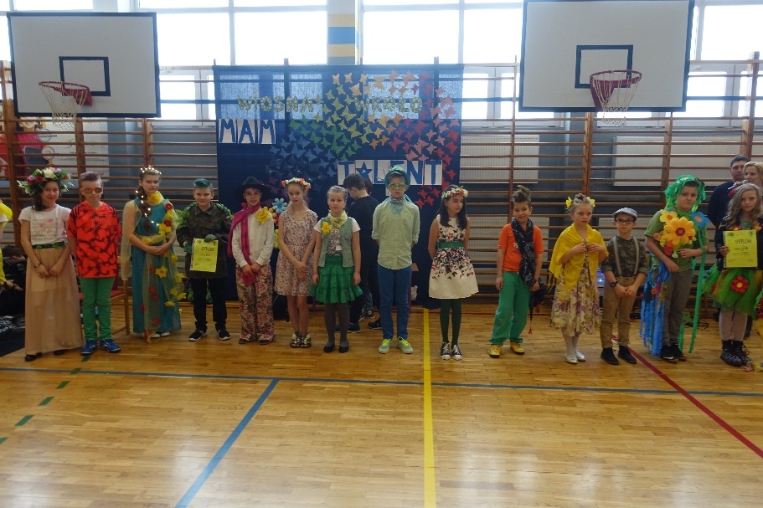
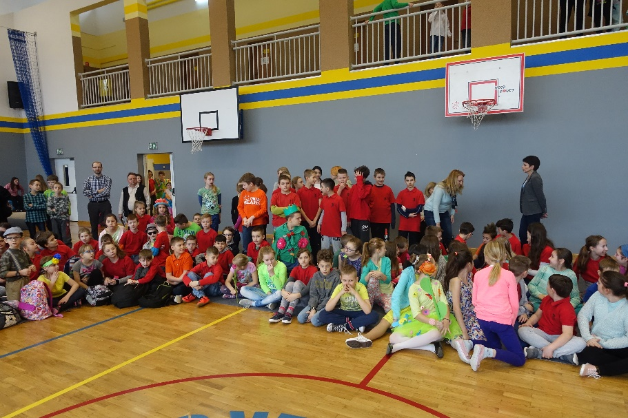

Slide 9
Logic Game Days

Slide 10
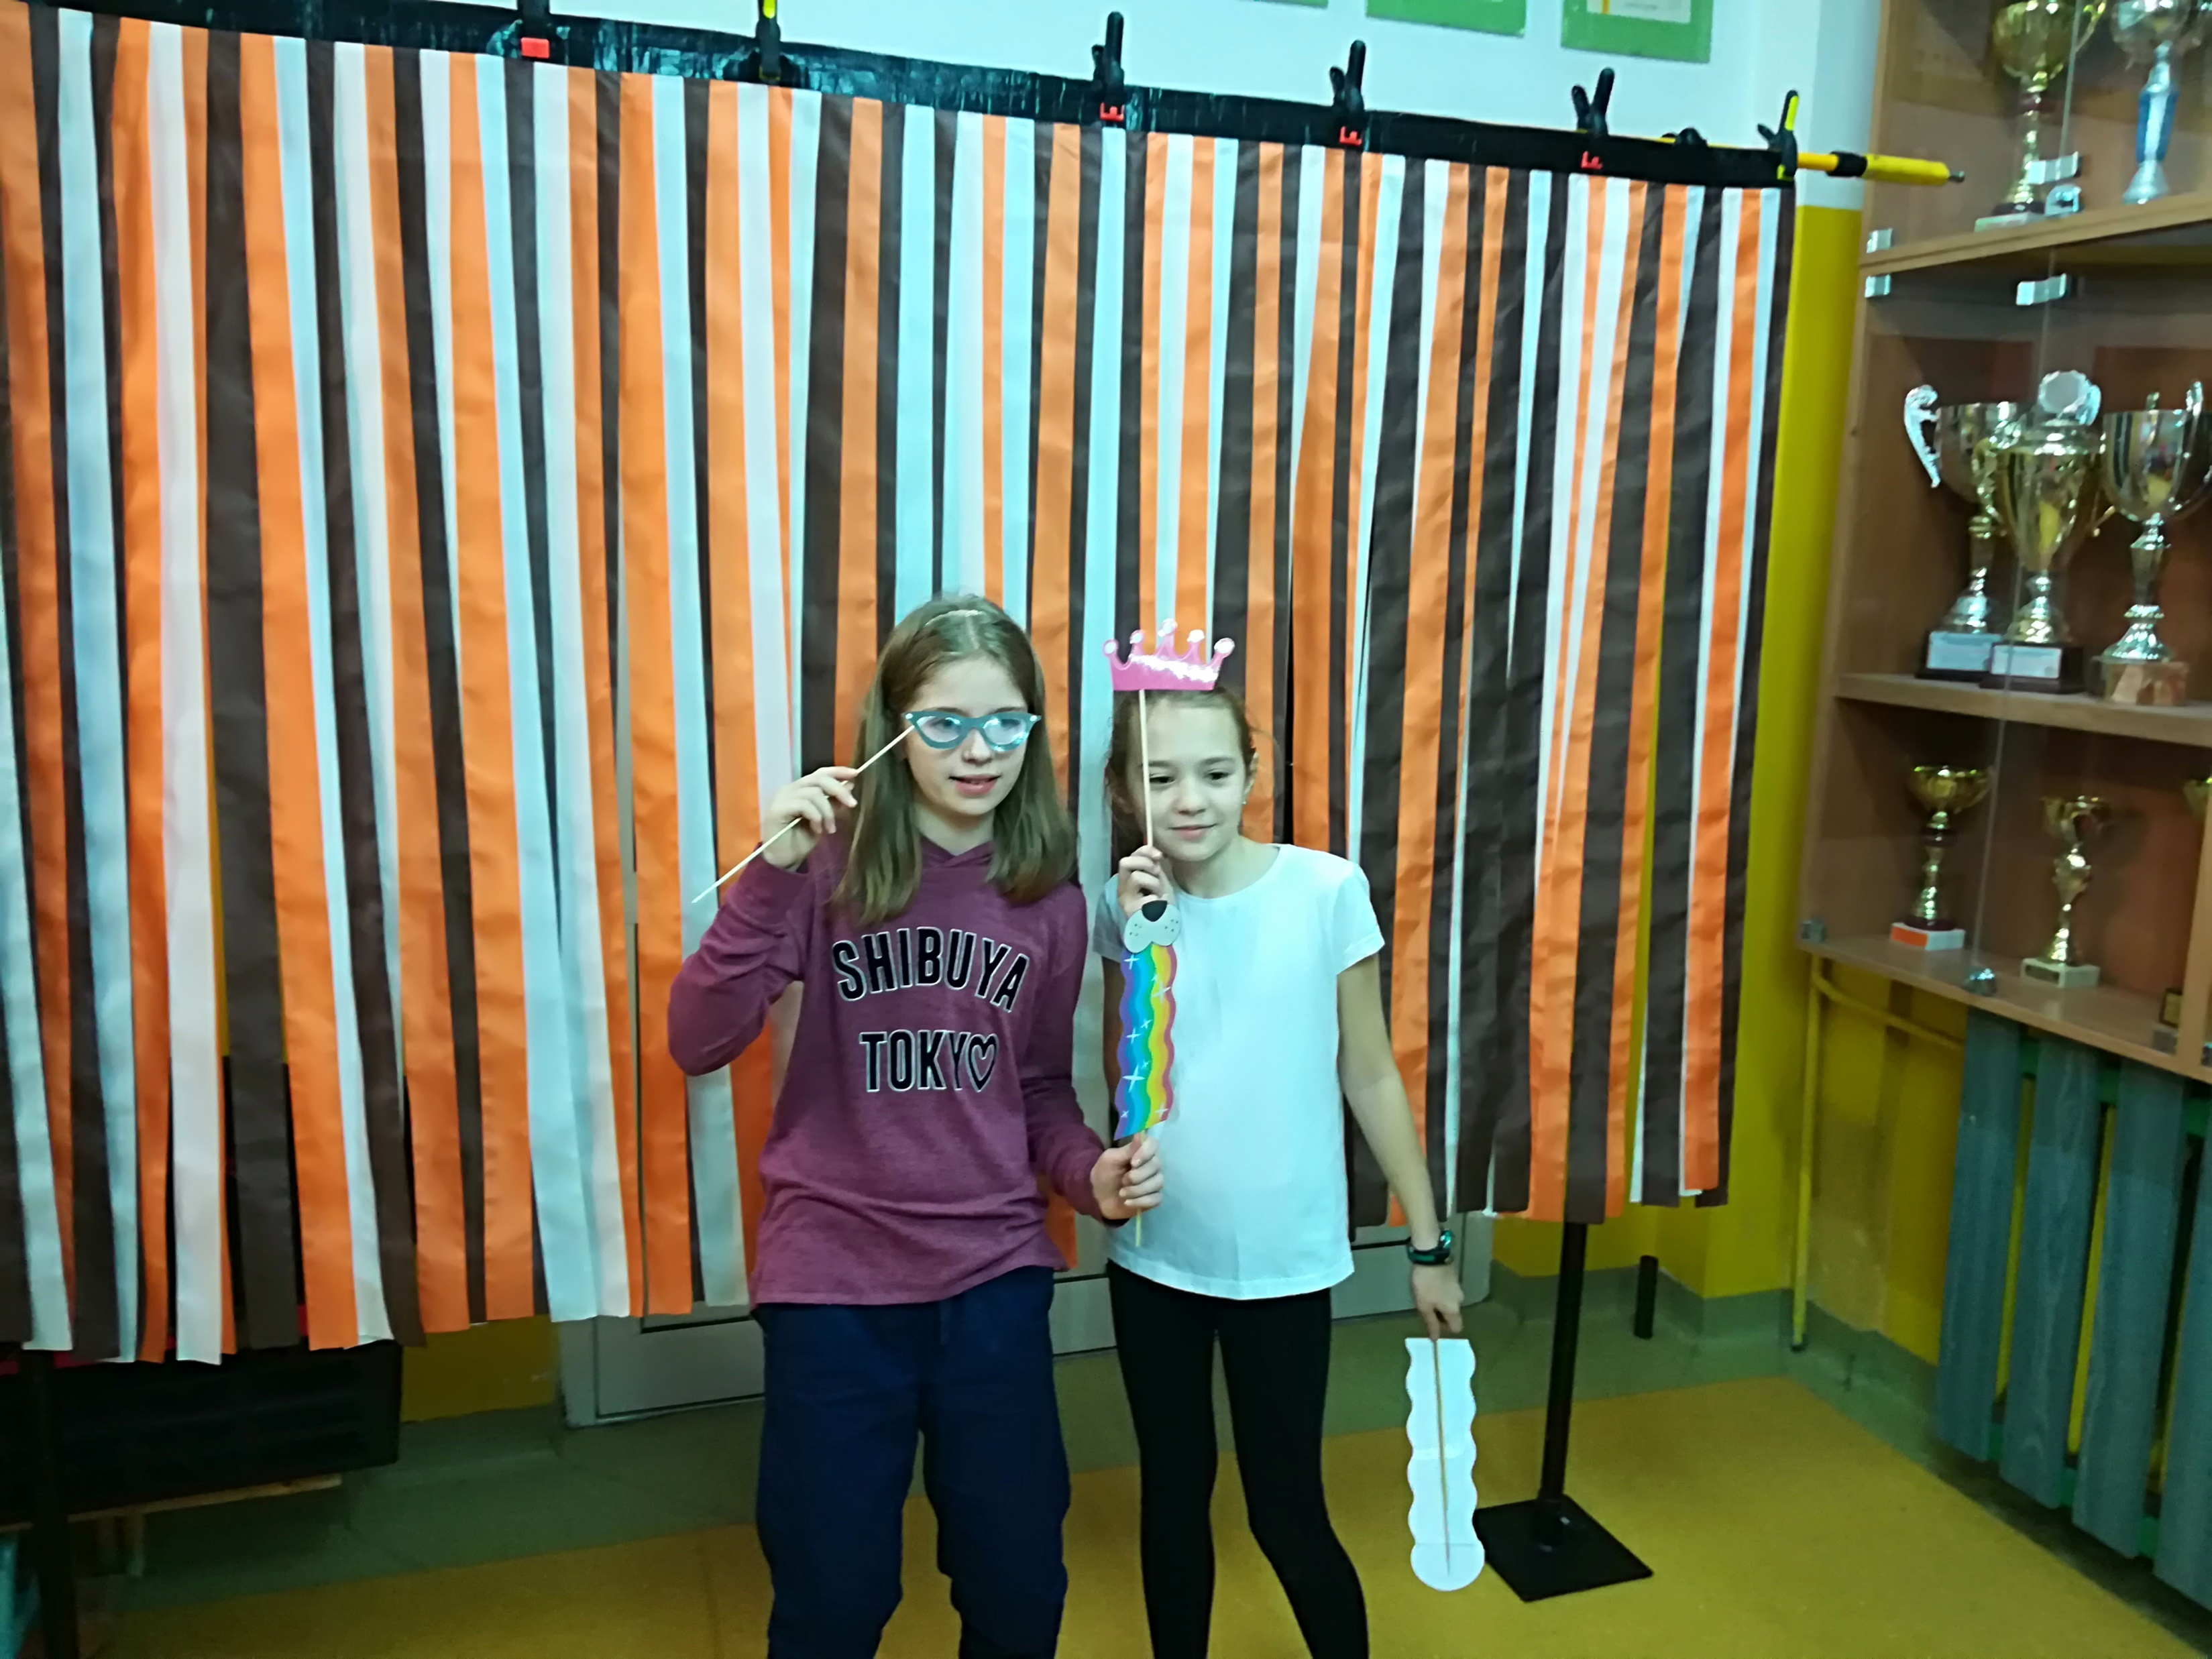
School’s Day
Every year in our school we celebrate its „birthday” We have sports competitions. We play board games and we have school academy. This year we could take a photo in a photobooth. There was a charity lottery. It was a lot of fun ! Last year we made a mannequin challenge:
Link to the video: https://youtu.be/fVyC7gcmKVc

Slide 11
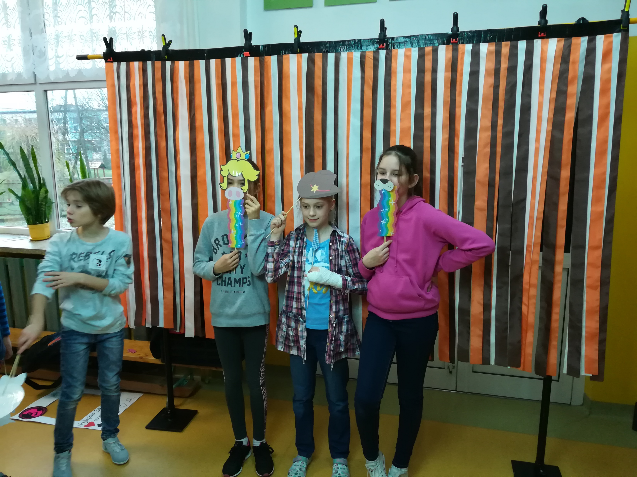
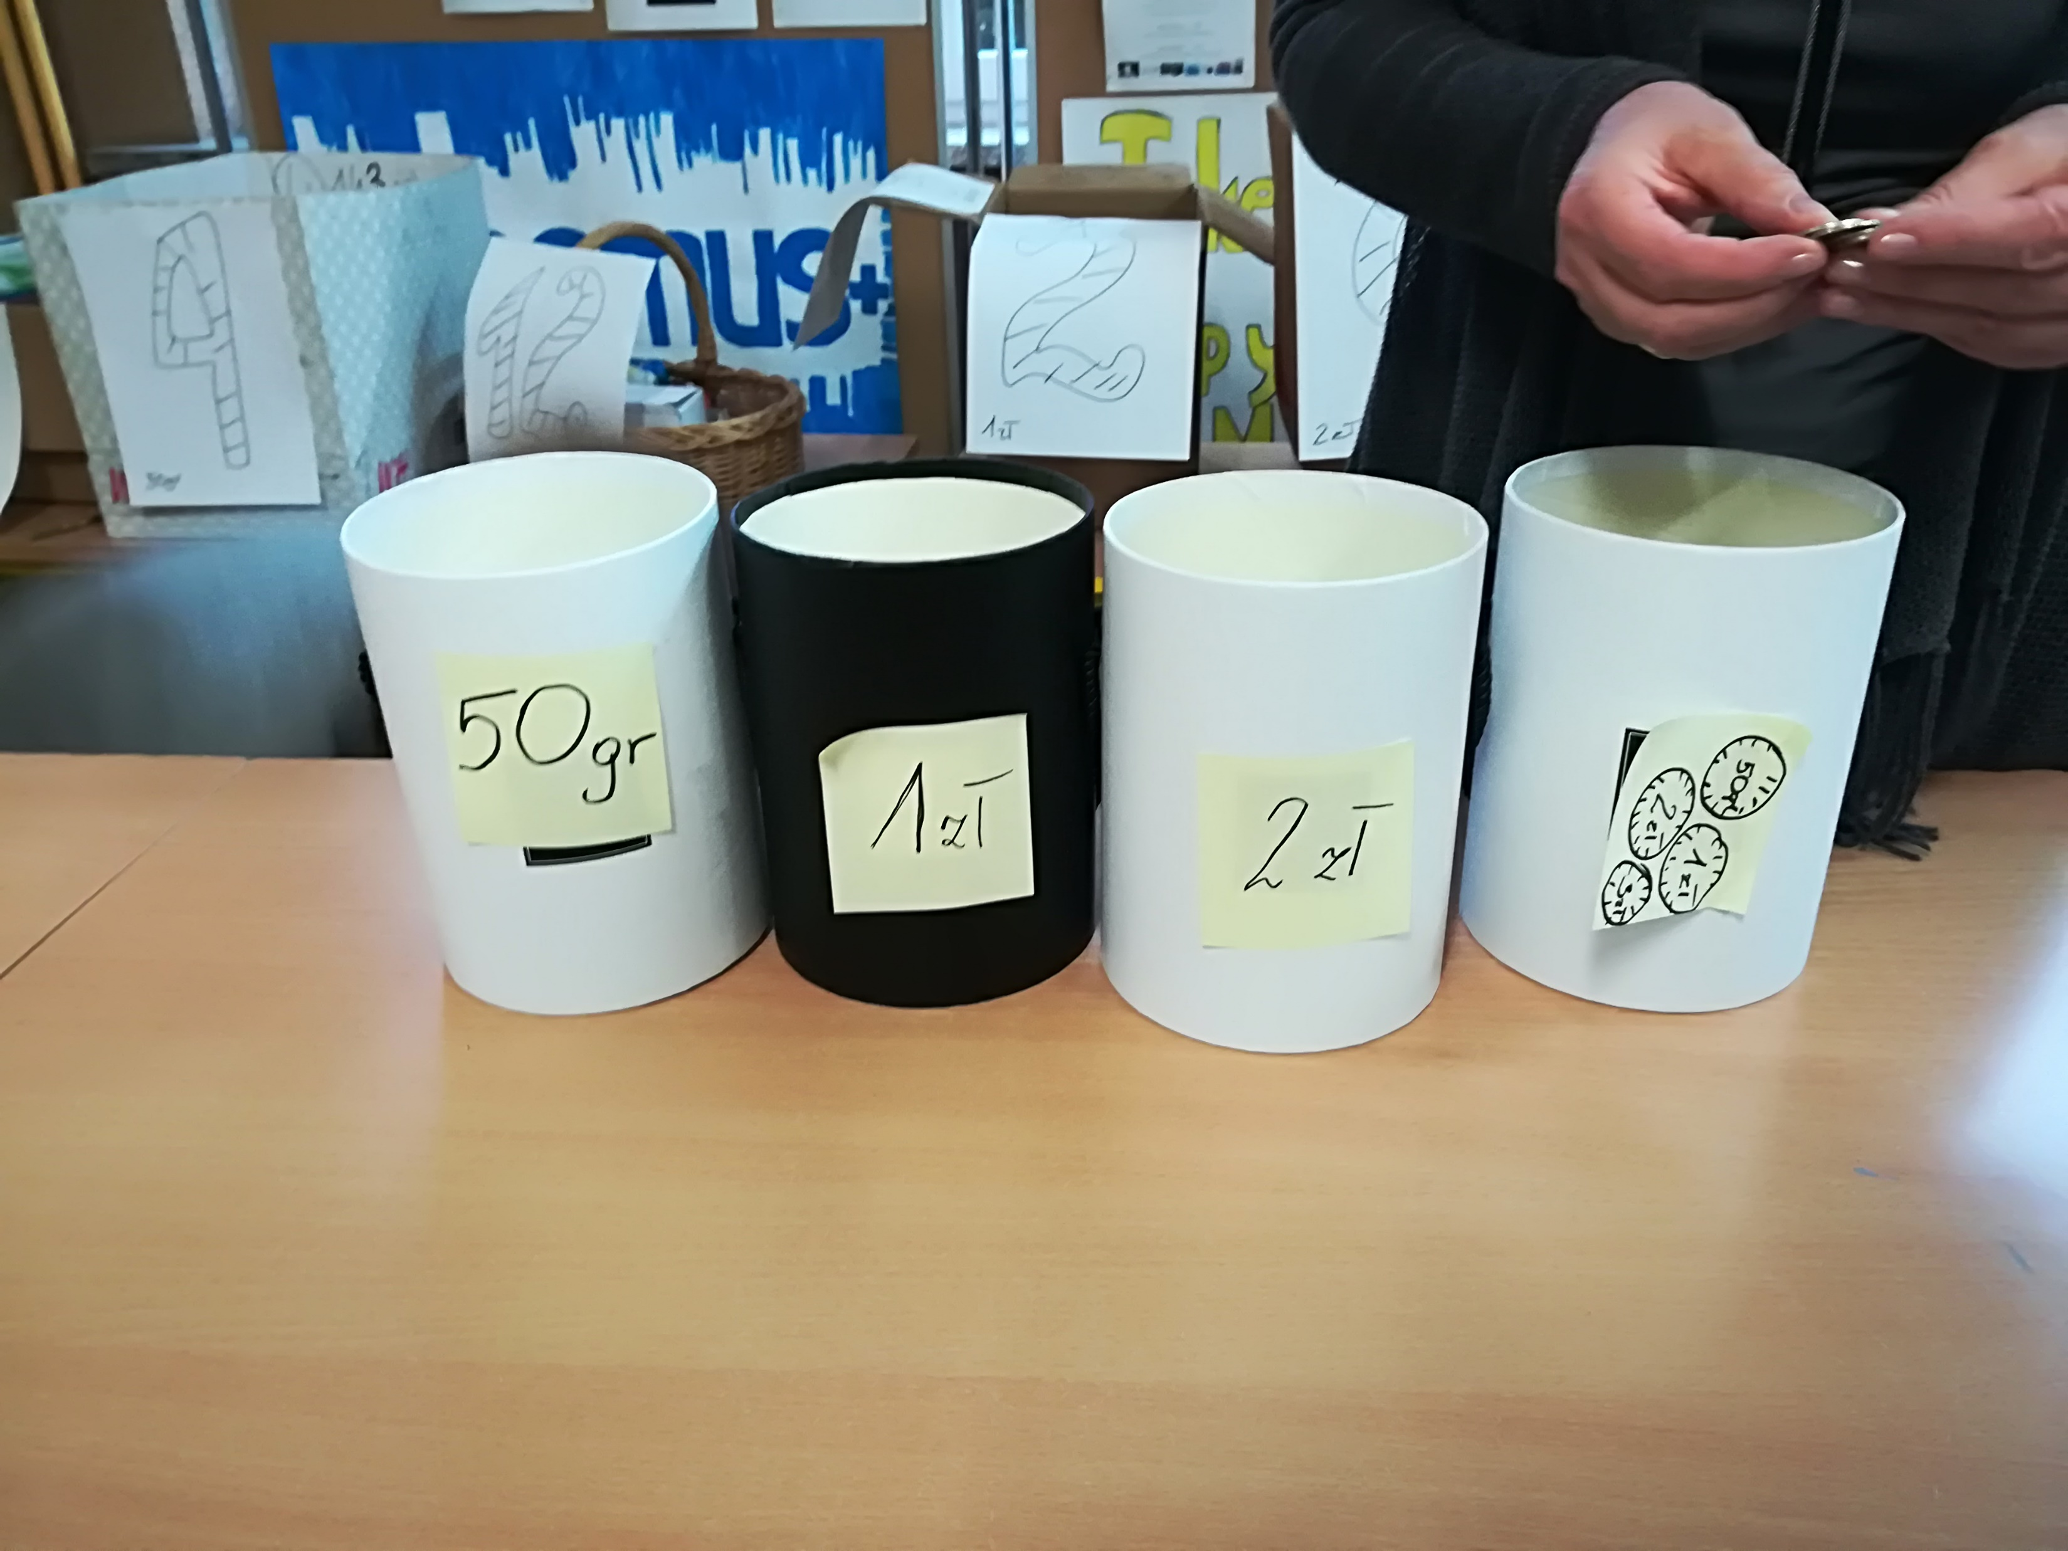
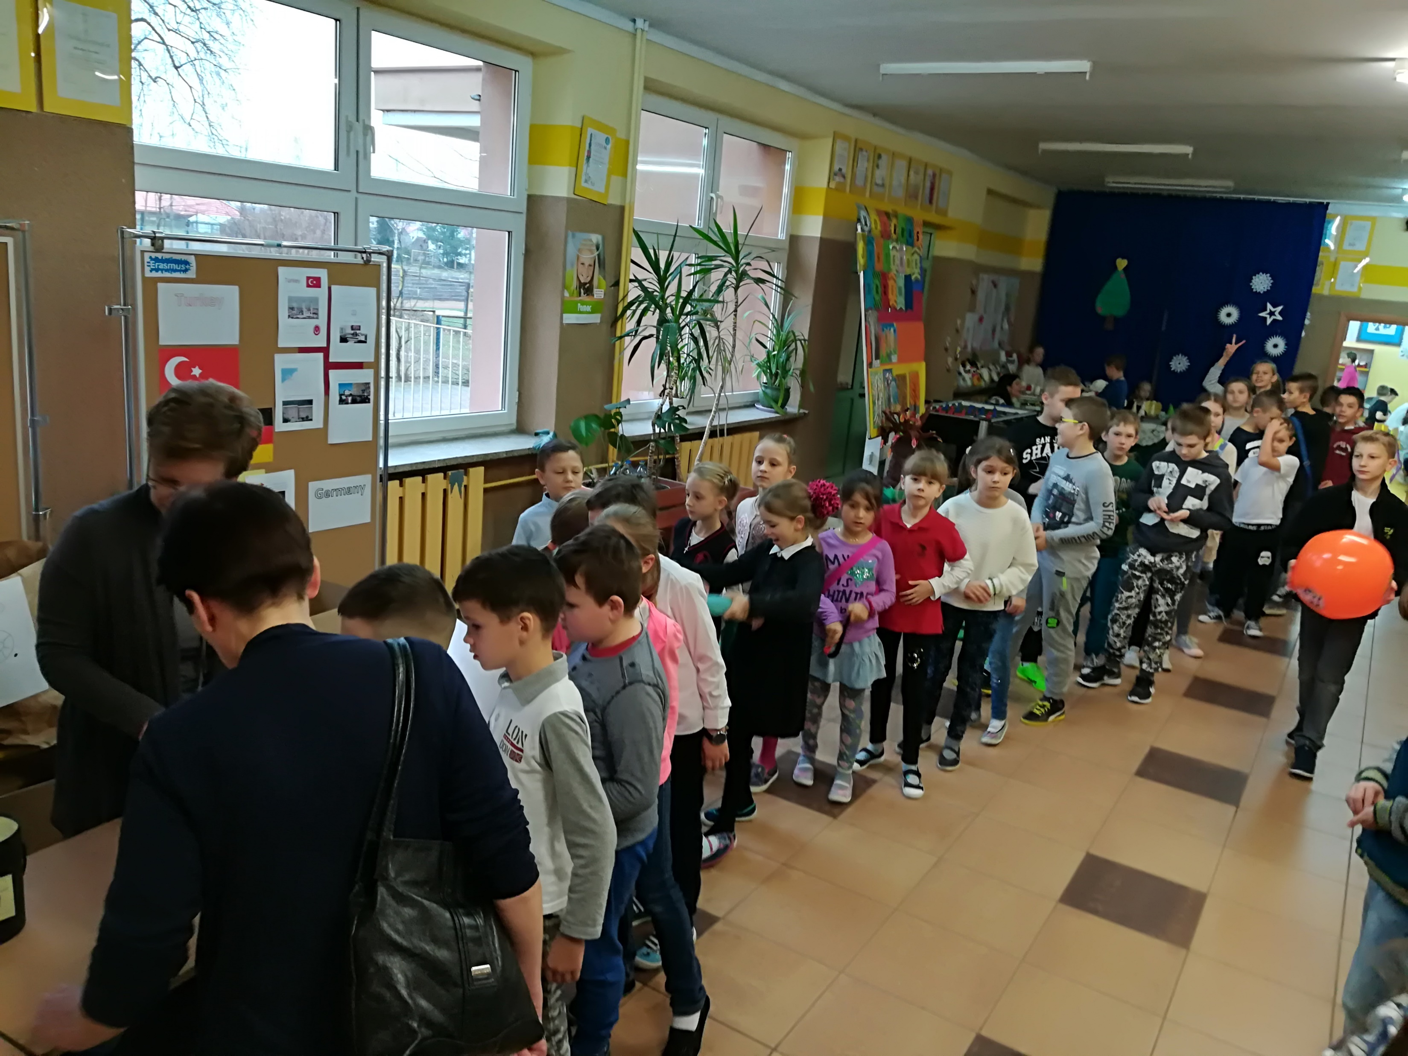
School’s Day

Slide 12
E-twinning and Erasmus+ projects

Slide 13
As the language learning and cultural awerness are also very important issues, students have possiblity to participate in European projects such as E-twinning and Erasmus+

Slide 14
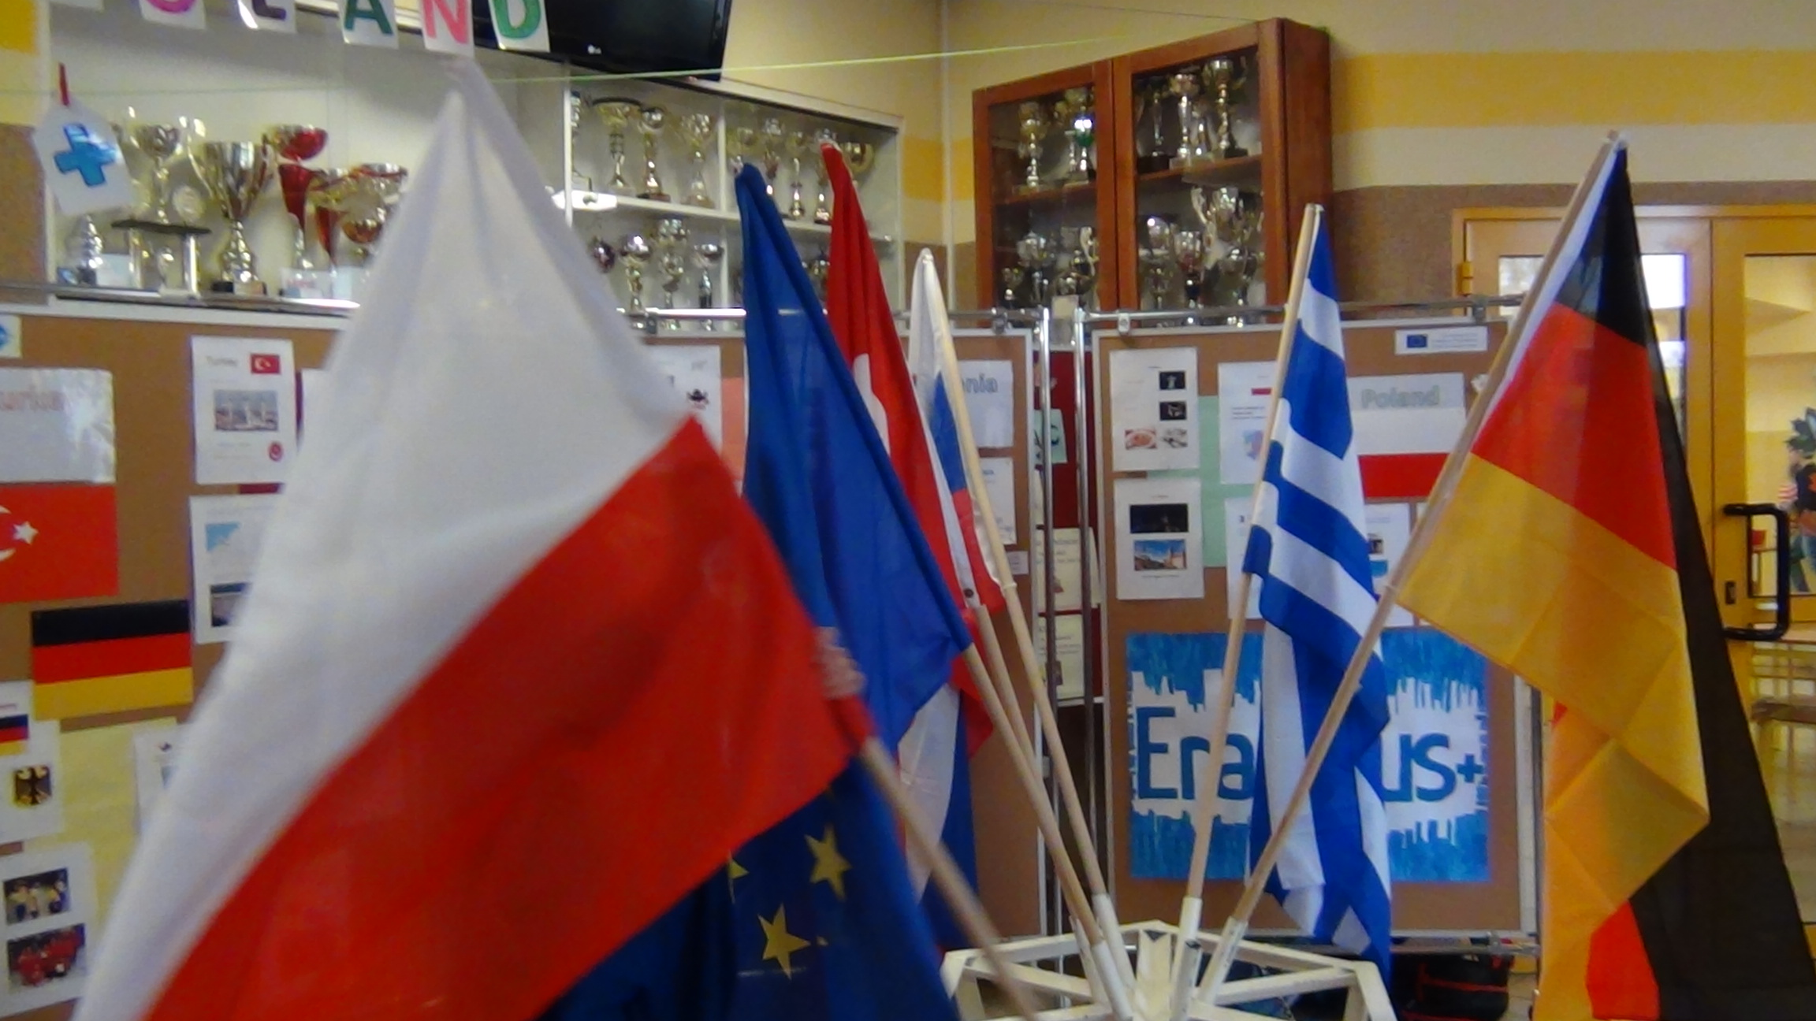
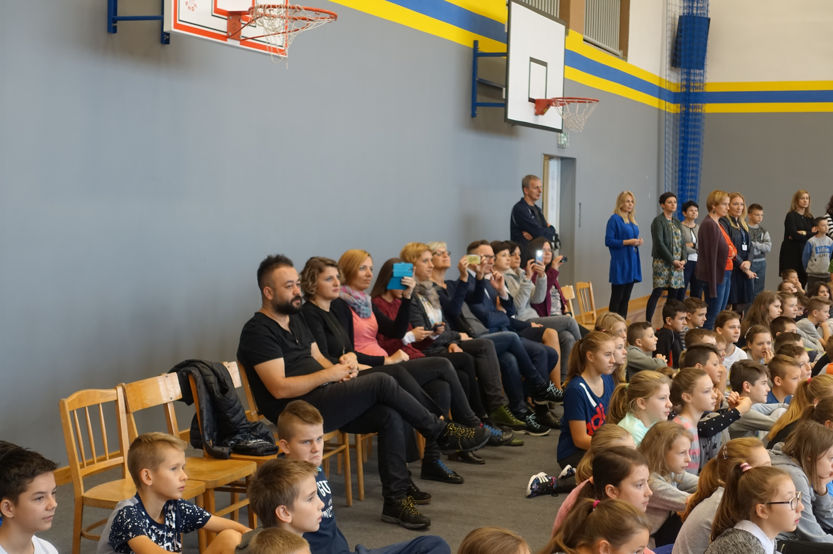
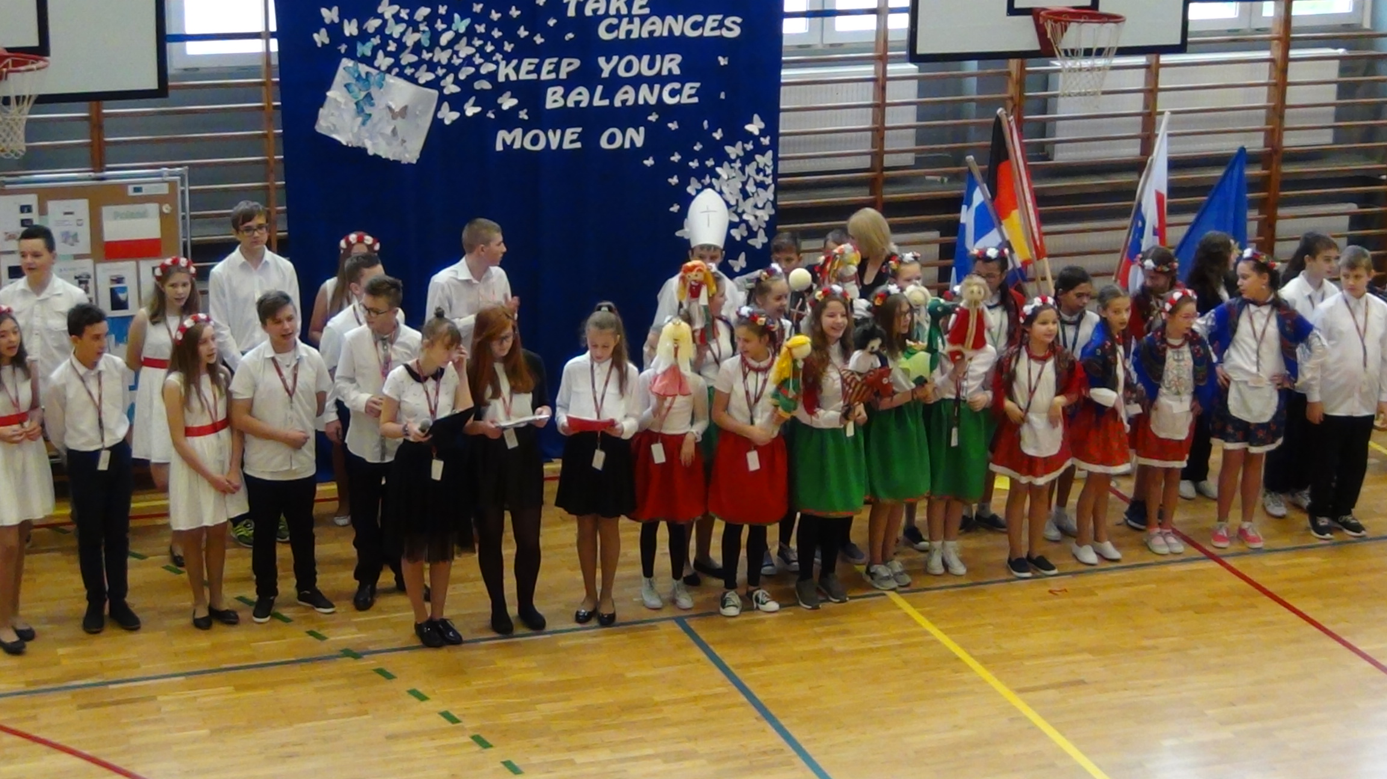
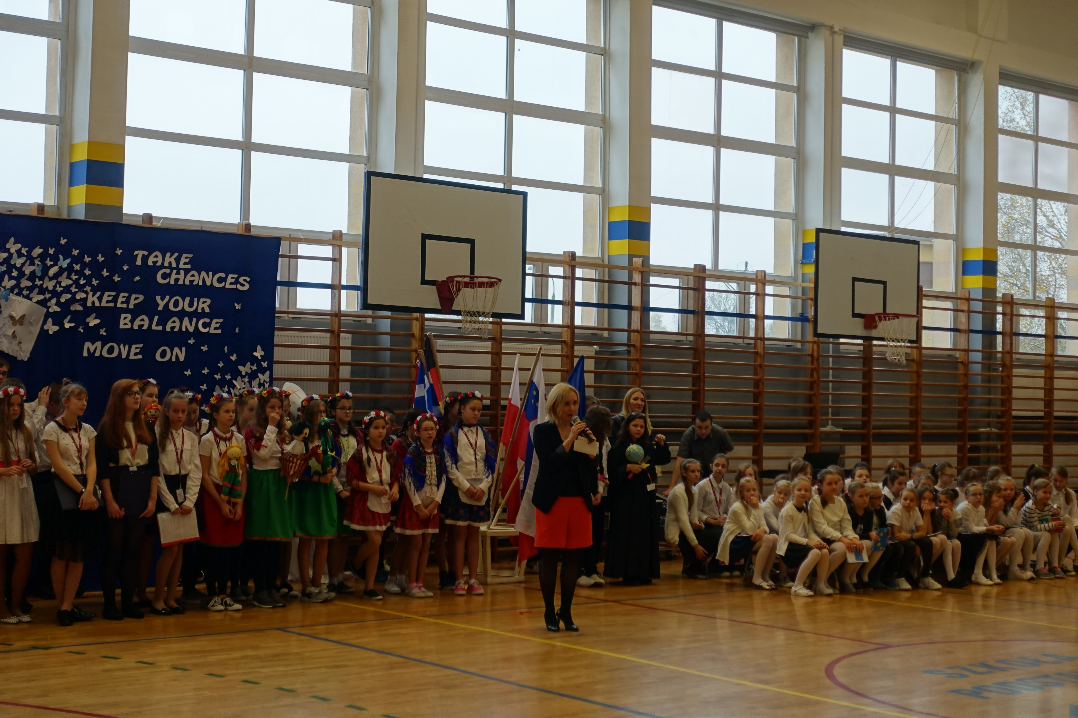
Erasmus+ Meeting in Poland

Slide 15
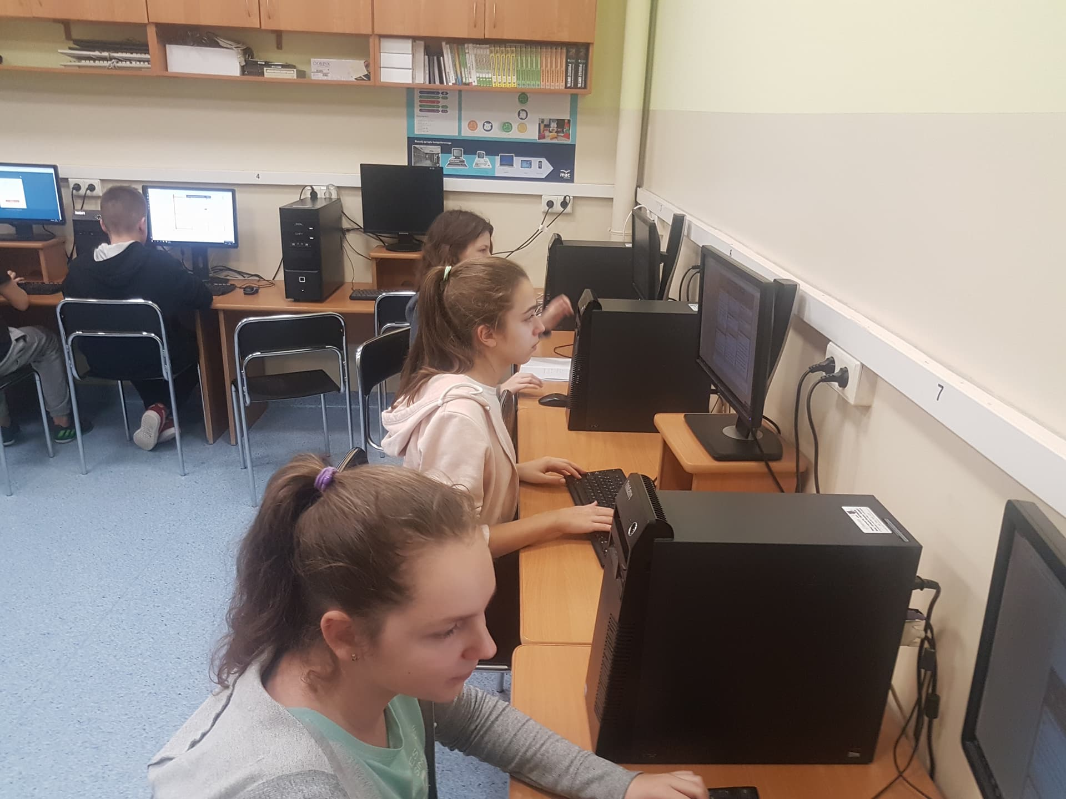
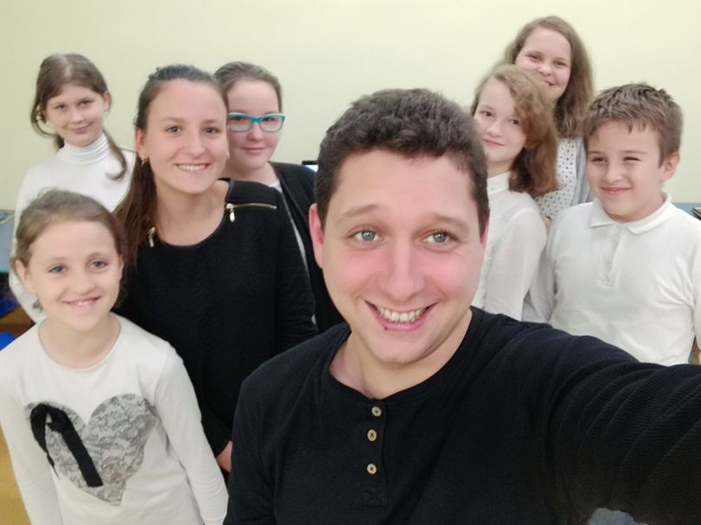
Erasmus+ groups from Poland

Slide 17
Thank you
Erasmus+ Group

